Slide 1
Strength of Materials
Module 1
Dr. G.Venkatachalam
Professor / SMEC
VIT Chennai Campus
Chennai

Slide 2
Rigid body (Engineering Mechanics)
Deformable body (Strength of Materials)
Elastic Deformation
Plastic Deformation
Strength (Internal Resistance)
Meaning of Strength, Hardness, Toughness, Rigidness, Stiffness

Slide 3
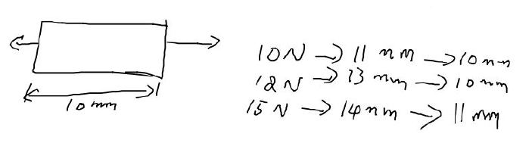
Deformable body
Elastic
Temporary
Recoverable
Plastic
Permanent
Non-recoverable
4 mm = (Elastic 3 mm) + (Plastic 1 mm)

Slide 4
Types of load
Time
Static Load / Dynamic load
Sustained load
Gradually (GAL) / Suddenly applied load (SAL)
Impact load (SAP + Momentum)
Area
Concentrated load
Distributed load
Location & Application
Centric load (Axial Load)
Torsional load
Flexural Load

Slide 5
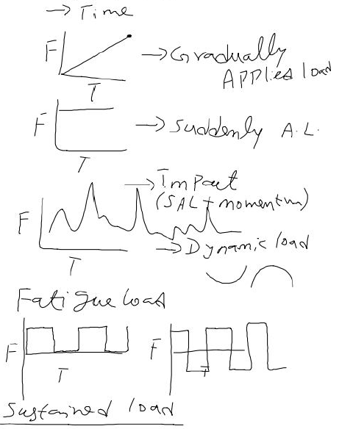
One takes few seconds to sit in a chair
One takes ZERO (or fraction of) second to sit in a chair
One jumps & sits sit in a chair
Load variation with time turbulent
Cyclic load – our academic calender (how???)
Load applied for longer period

Slide 6
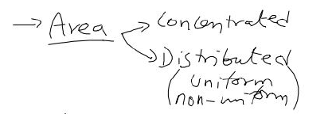
Example – same task is assigned to 2 teams (A & B)
Team A – only one member (load is concentrated)
Team B – 5 members (load is distributed among 5 members)

Slide 7
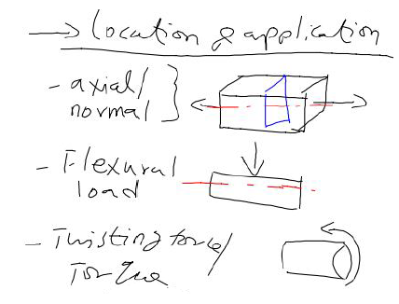
Load – parallel to axis of structure
Load – perpendicular to axis of structure
Load – along the circumference of structure

Slide 8
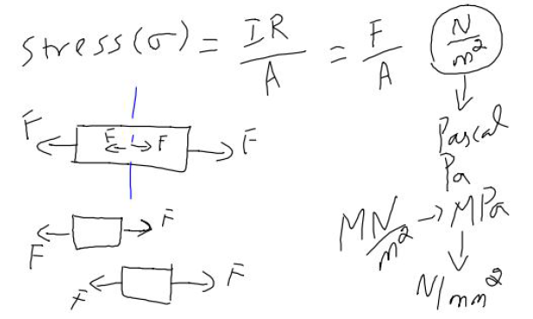
IR – internal resistance
Stress – can’t see; only calculated using formula

Slide 9
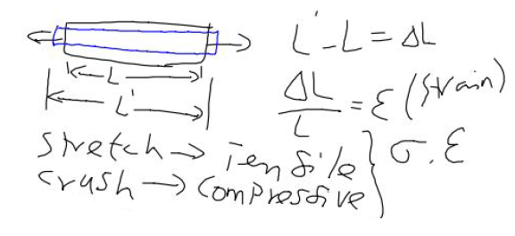
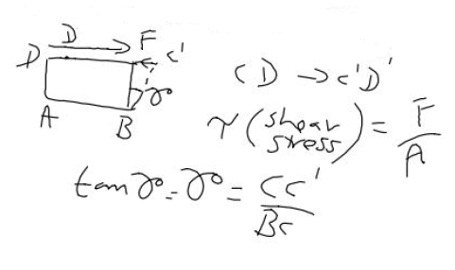
ΔL – change in dimension (length) – measurable; can see if significant
σ – normal / axial stress
ε - normal / axial strain
ΔL is + for tension
ΔL is – for compression
τ – shear stress
γ - shear strain
C’D’ – change in position

Slide 10
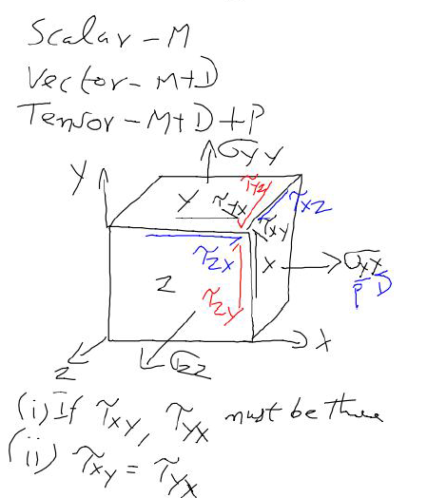
M – magnitude; D – direction; P - plane
Stress at a point
Shear stress & complementary shear stress

Slide 11
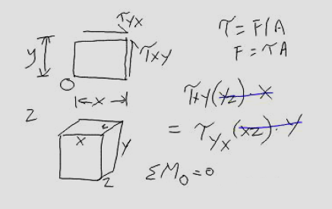
Steps to prove - Shear stress & complementary shear stress are same inmagnitude

Slide 12
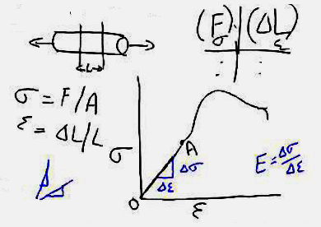
Stress (σ) – Strain (ε) curve
F & ΔL can be recorded from experiment

Slide 13
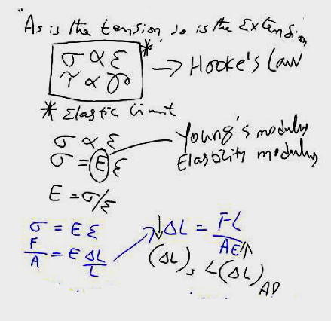
Meaning of E
Let’s consider 2 materials;
Steel & Aluminium
E (steel) > E (Aluminium)
Δ_{s} < Δ_{Al}

Slide 14
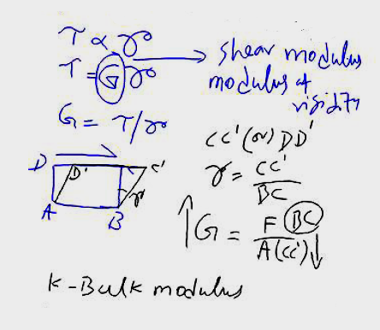
Meaning of shear modulus – rigidness of materials – CC’ (or) DD’

Slide 15
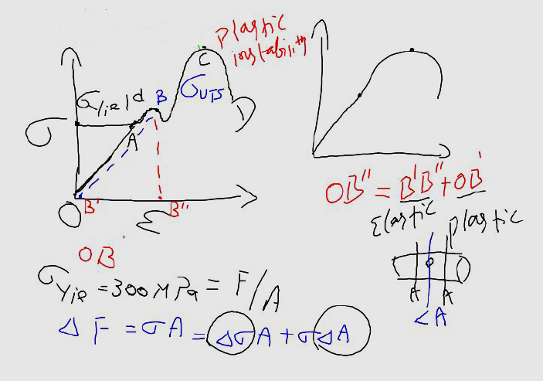
Stress (σ) – Strain (ε) curve – more information
O - origin
A – Yield point
B – upper yield point
C – Ultimate point
D – Failure point
Crack forms when loading is at C
Internal resistance beyond yield point
Geometry effect
Material effect

Slide 16
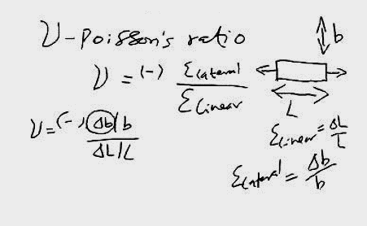

Slide 17
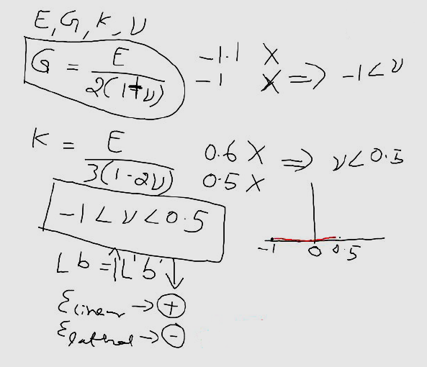
E – Young’s modulus
G – Shear modulus
K – Bulk modulus
ν – Poisson’s ratio
Range of Poisson’s ratio

Slide 18
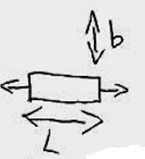
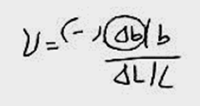
Range of Poisson’s ratio: -1<ν<0.5
If Poisson’s ratio is (-)
Δb is (+)
If Poisson’s ratio is (ZERO)
Δb is (ZERO)
If Poisson’s ratio is (+)
Δb is (-)

Slide 19
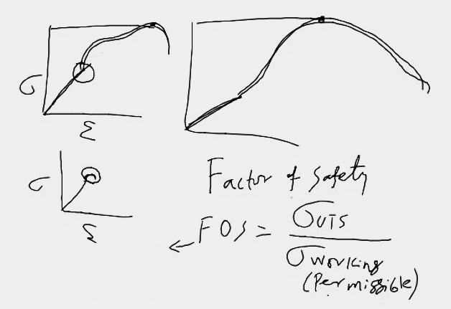
Factor of safety – important for design engineers – WHY???

Slide 20
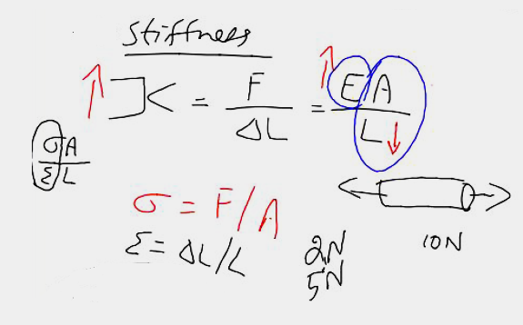
More stiff – which one?
1m steel rule
1 feet steel rule
1feet paper rule
1 feet steel rule
1 feet steel rule
1 feet steel rule
Geometry
Material
Flexibility – opposite of stiffness
Flexibility = 1/Κ

Slide 21
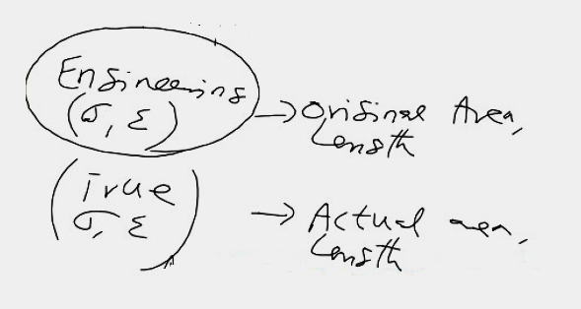
Engineering stress / strain & True stress / strain

Slide 22
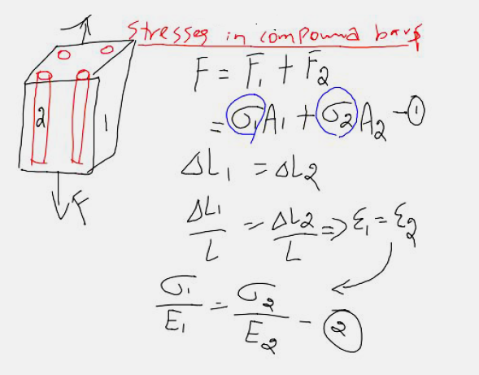
Applied load is shared by constituent materials
If bonding exists between materials 1 and 2, change in dimension is same

Slide 23
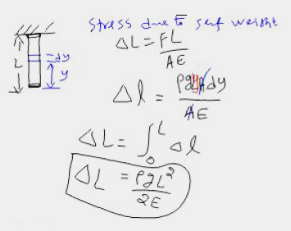
Stress due to self weight

Slide 24
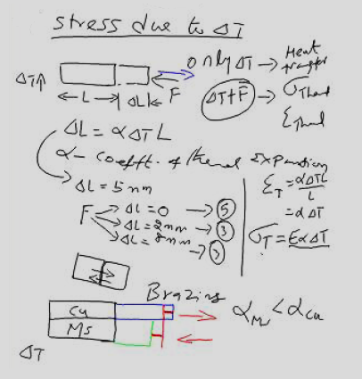
Stress due to change in temperature
ΔL - Change in length due to Δt
If two different materials are joined, difference in coefficient of thermal expansion offers force

Slide 25
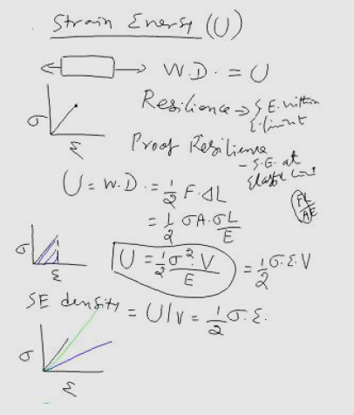
Strain energy
Resilience
Proof resilience
Strain energy density
Toughness??

Slide 26
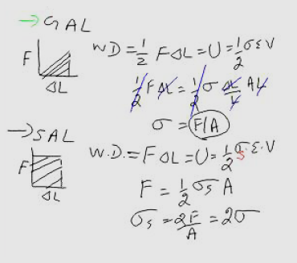
Gradually applied load (GAL)
Suddenly applied load (SAL)

Slide 27
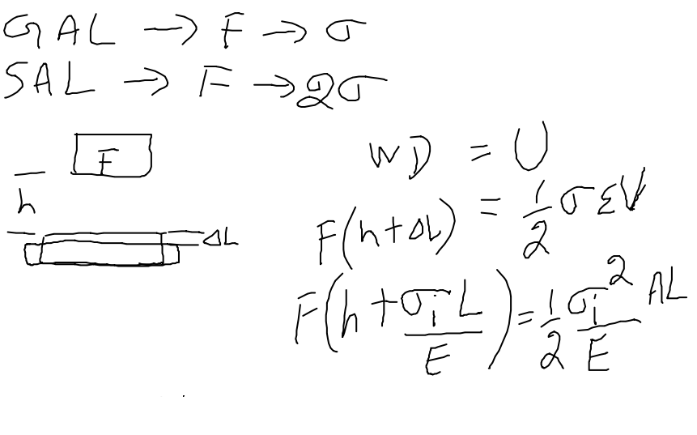
Stress doubled if ‘F’ is applied as SAL
if ‘F’ is dropped……
SAL + momentum = impact load

Slide 28
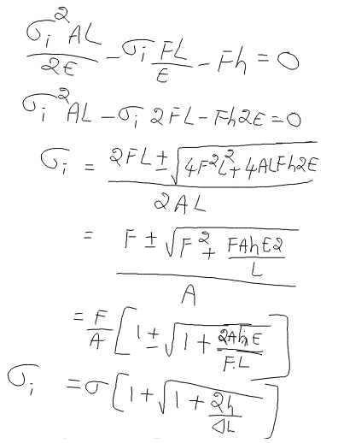

Slide 29
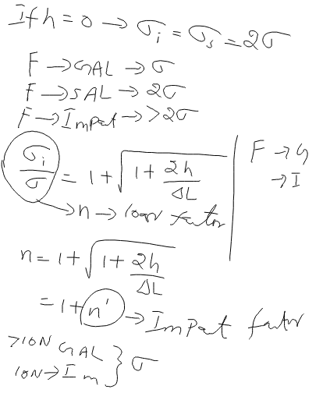
Comparison of GAL Vs SAL Vs impact load

Slide 30
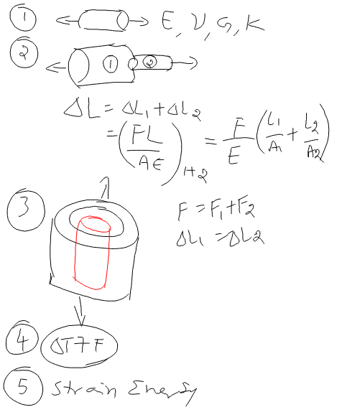
Types of numerical / problem from module 1

Slide 31
Tutorials

Slide 33
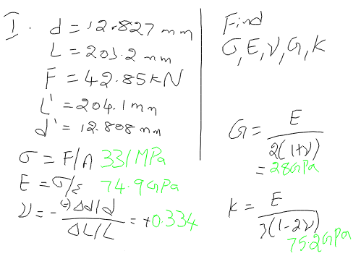
1

Slide 35
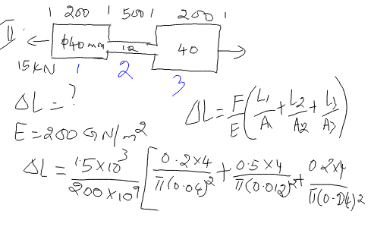
2

Slide 36
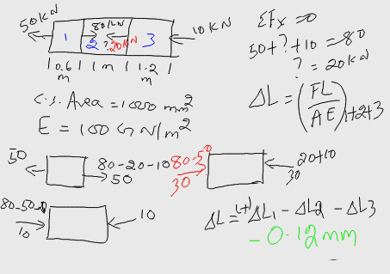
3

Slide 38
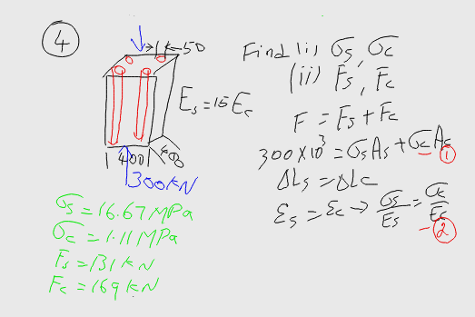
4

Slide 40
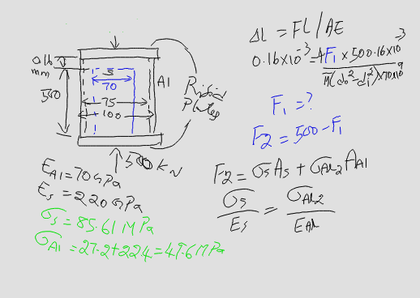
5

Slide 42
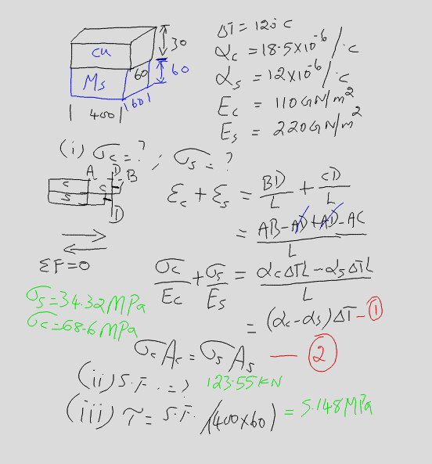
6

Slide 43
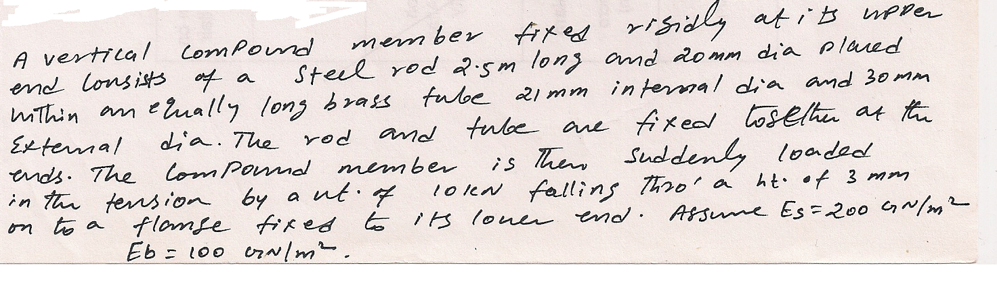

Slide 44
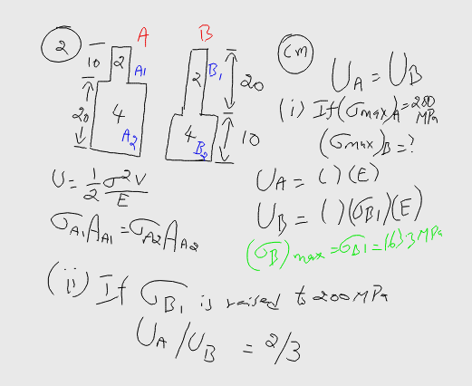
7

Slide 45
Thank you

